Slide 1

SSC in Integrative Medicine
Resilience-building Whole Person Care with a focus on cancer
Dr Catherine Zollman
Dr Duncan Still

Slide 2
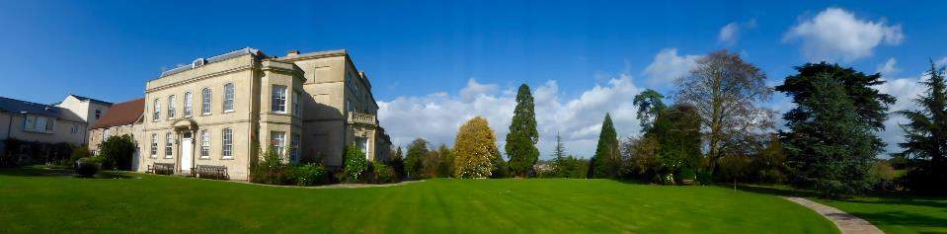
Experiential taught SSC
Regular teaching and supervision by Clinicians
  Learn skills in nutrition, exercise, relaxation
Min 26hrs patient contact
  including participation in 2-day self-management course and cookery demonstration

Slide 3
Based at Penny Brohn UK National Centre
Beautiful state-of the-art Healthy Living Centre in Pill (4 miles from central Bristol with easy public transport links)
35 years experience in providing Integrative, Holistic Cancer Support

Slide 4
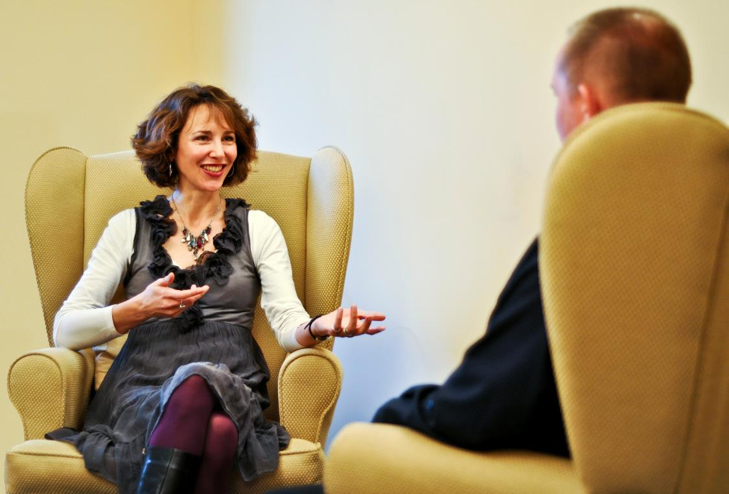
Types of activity you will learn about (1)
Integrative Doctor Sessions
Learn how you, as a doctor, can help patients combine the best of conventional medicine with lifestyle self-management and complementary therapies
Develop your holistic assessment abilities and confidence
Practise motivational techniques and health-coaching skills
Become more confident dealing with life-threatening and long term conditions
Notes:
Lifestyle related long term conditions
4

Slide 5
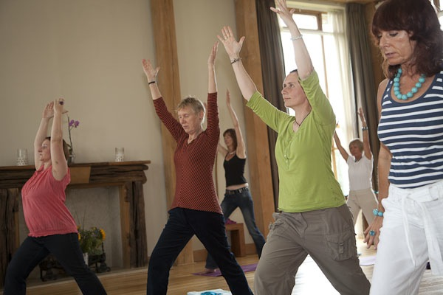
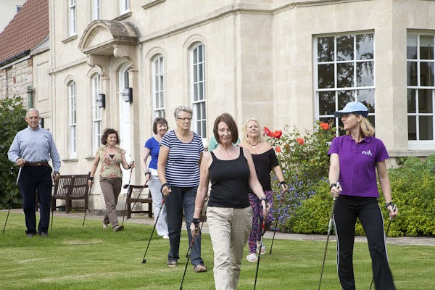
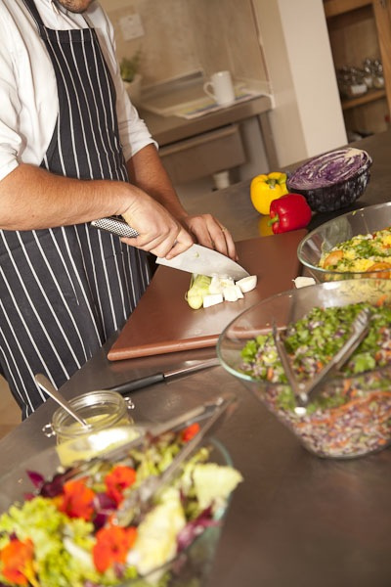
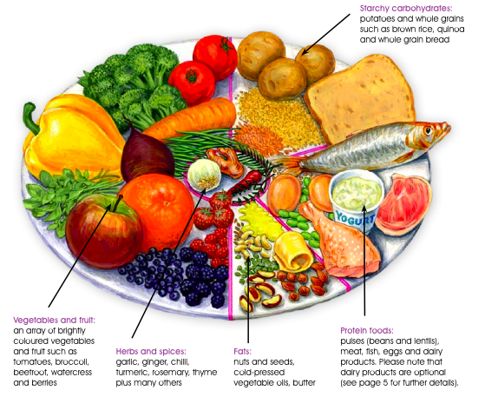
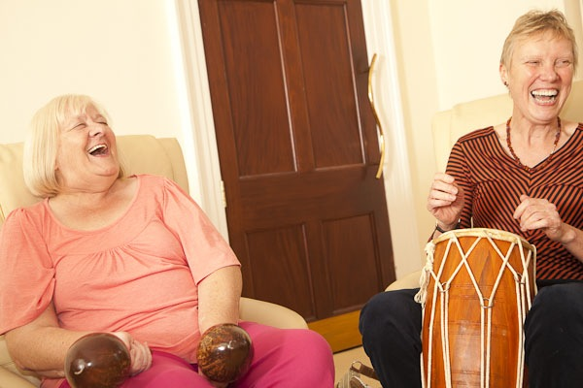
Types of activity you will learn about (2)
Physical Activity
Yogathrive
Nordic Walking
Tai Chi / Qi Gong
Cancer rehabilitation
Biodanza
Healthy Eating
Cookery demonstrations
1-1 Nutritional counselling
Mind-body and creative therapies
Counselling & Applied Relaxation
Guided Imagery
Music & Art therapy
Peer support and group work
Notes:
Lifestyle related long term conditions
5

Slide 6
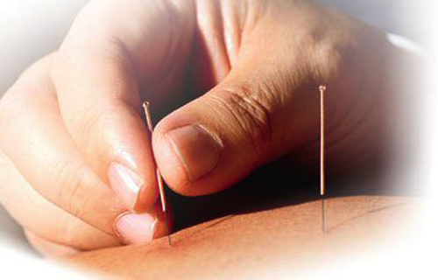
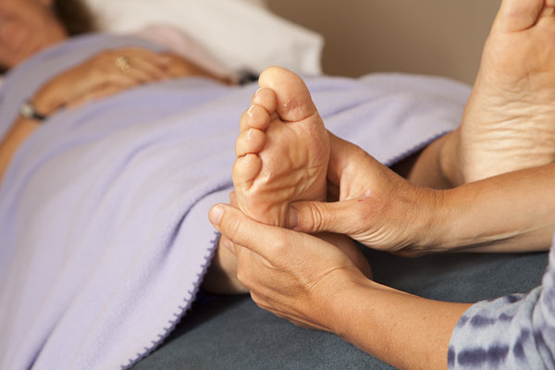
Types of activity you will learn about (3)
Complementary Therapies
Massage
Shiatsu
Reflexology
Acupuncture
Healing
Pragmatic, evidence-informed
Favourable risk-benefit ratio
Accredited, experienced practitioners
Notes:
Lifestyle related long term conditions
6

Slide 7
Learn about how integration of
Medical and Surgical approaches with:
  self-management education
  nutrition
  physical activity
  mind-body approaches
  peer support
  complementary therapies
can improve patient experience and clinical outcomes

Slide 8
Contribute to the field of Integrative Medicine
Student projects may include:
  Producing evidence based information sheet for nationwide network of cancer patients
  Opportunities to present work at conferences and in journals

Slide 9
Patient experiences
“I’ve been more confident in how I have dealt with my illness and feel that taking responsibility for my wellness has enabled me to speak to professionals about what I want. My attendance on the course was a real education for which I am very grateful.”
Living Well course participant 2010
Notes:
Co-morbidities helped by LW course

Slide 10
Patient experiences
“The Living Well course has shown me how I can help and support myself physically, emotionally and spiritually. It has placed me on a pathway of learning and understanding and allowed me to make choices which have had a positive benefit on my health and which keep my body and mind well.…. And the best thing is, I feel amazing.
Cancer has made a massive impact on my life. So has Penny Brohn”.
Living Well participant, Hull (Jan 2013)

Slide 11
Patient experiences
"At my initial one-to-one session with an integrative doctor, we went through the Bristol Whole Life Approach. It was like music to my ears after the hospital experiences. The Approach was inspiring, empowering and resonated with me on so many levels. It gave me the strength to make decisions about my lifestyle and have some control in my wellbeing.”
Penny Brohn Day Services client (2015)

Slide 12
Patient experiences
"One of the biggest things for me, about going to Penny Brohn, is seeing the doctors. Seeing an integrative doctor is revolutionary for me. Having a medical sounding board is perfect to discuss confusing things. Importantly, it’s someone who understands that you’re a whole person and that you’ve preferences or things to think about... It makes a huge difference knowing that there’s somebody that you can trust, who sees you as a whole person and can talk you through complicated medical decisions. I don’t feel like I’m on my own.”
Penny Brohn Day Services client (2016)

Slide 13
Patient experiences
“During one [Treatment Support Clinic] session, I received a prescription from the doctor to be “excessively gentle” to myself during chemo. Now where else in the World does a doctor prescribe that?!”
Penny Brohn Treatment Support Clinic client (2016)

Slide 14


